Slide 1
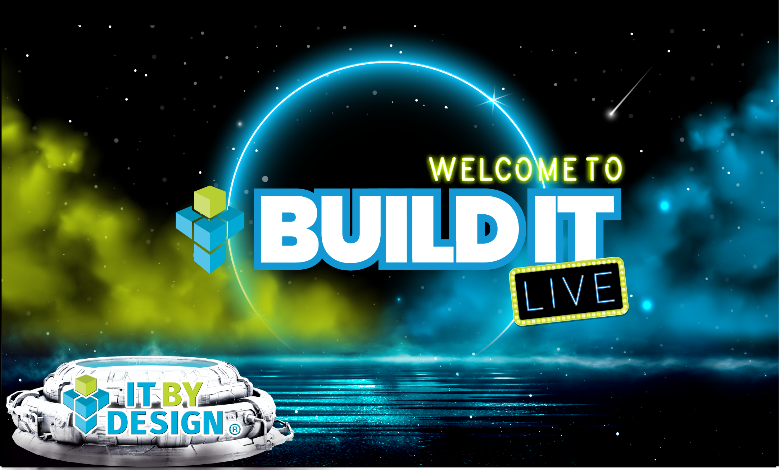

Slide 2
Good Salespeople are not born, they are BUILT
The tools and process you need to BUILD an effective salesperson
Kam Kaila
Kyle Van Vlack

Slide 3
Sales is Tough
Great Salespeople don’t make it to the top without hard work
IT TAKES A PROCESS
Having a system that works
THE RIGHT TOOLS
They aren’t cheap, but when used right, they are effective
CREATIVITY IN MESSAGING
Getting through to setup the call is key
PERSISTENCE
If at first you don’t succeed…. Try, try, and try again.

Slide 4
Meet Kyle
No one is born a salesperson, they are developed.
Process
Tools
What activities work, when to follow up, and how often
Marketing Automation Tool, LinkedIn Sales Navigator, Data List Service, LinkedIn Automation tool
Structure
Portfolio
Manage day to day performance and metrics
Sales Collateral, Client testimonials, references

Slide 5
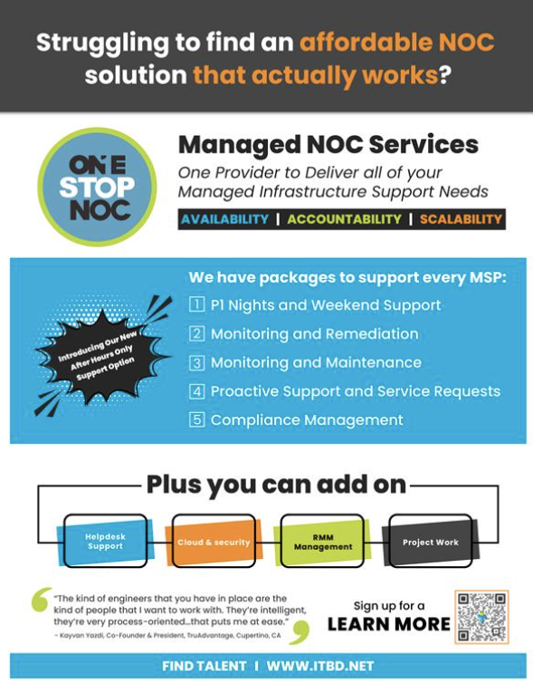
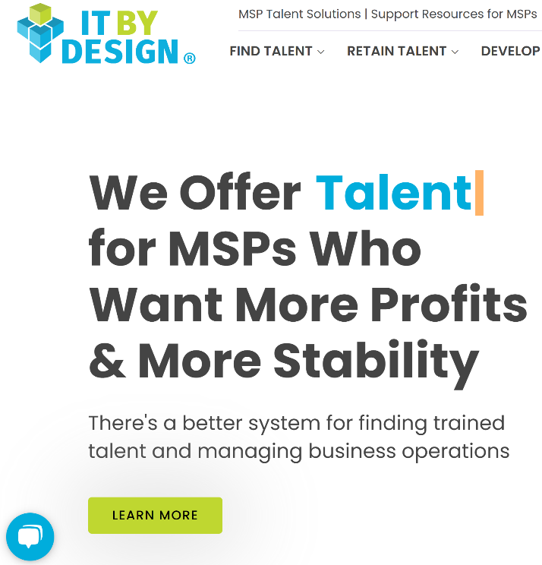
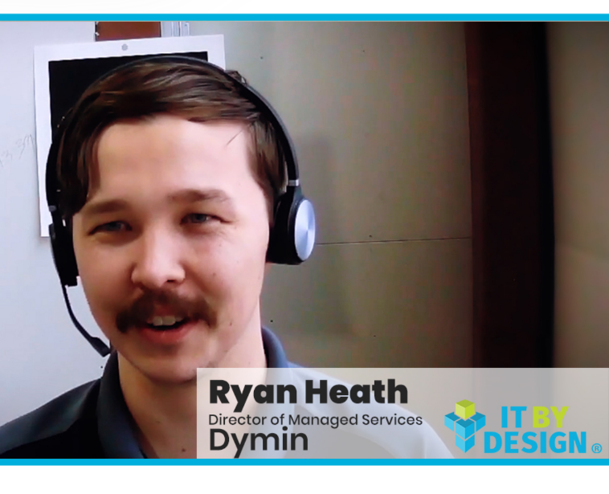
Prepare a Portfolio
Sales Collateral
Website
Testimonials
Informational Product Sheets | Brand books | Corporate PPTs
Up to date website, with products and services that are clear to understand
Client recorded testimonials | References List by Product

Slide 6



Tools Matter
Making sure that we provide team with the right tools to make an impact is important in ensuring success
Business Intelligence
Marketing Automation
LinkedIn Messaging
List Management
LinkedIn Sales Navigator
Hubspot
Salesforce
MindMatrix
Infusionsoft
Dripify
DuxSoup
ZoomInfo
SalesIntel

Slide 7
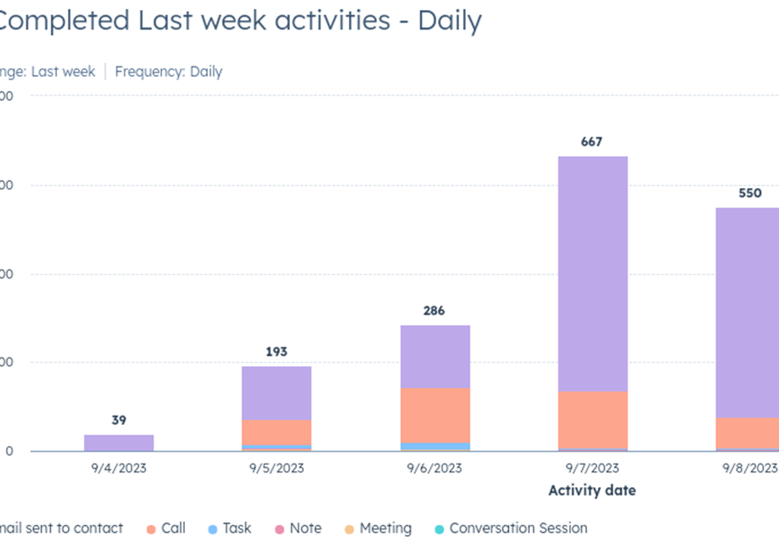
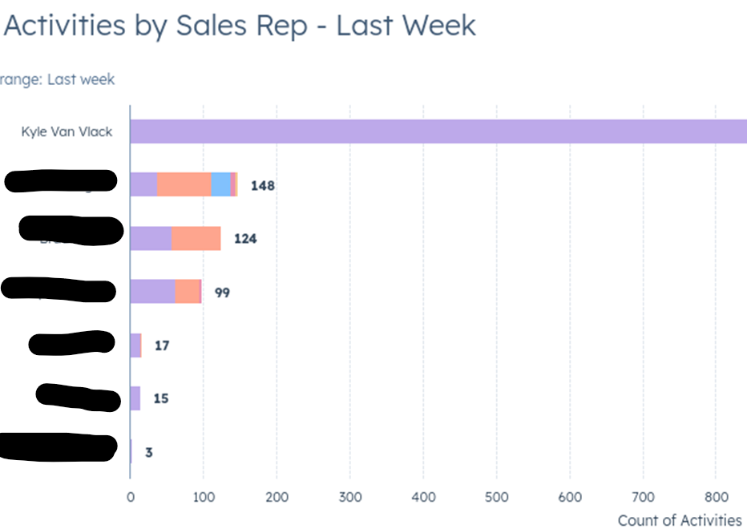
Prepare a Structure
Daily Activity Goals
Inspect what you expect - Reporting

Slide 8
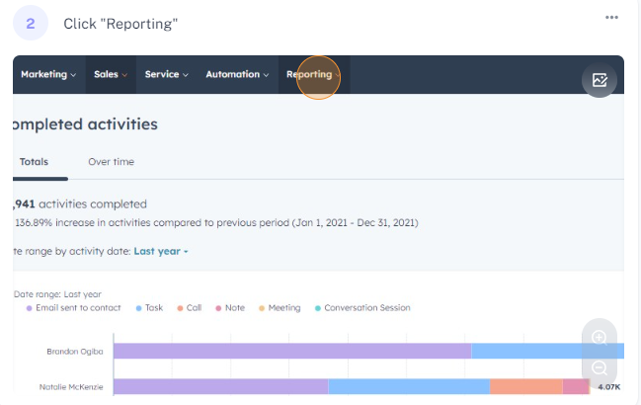
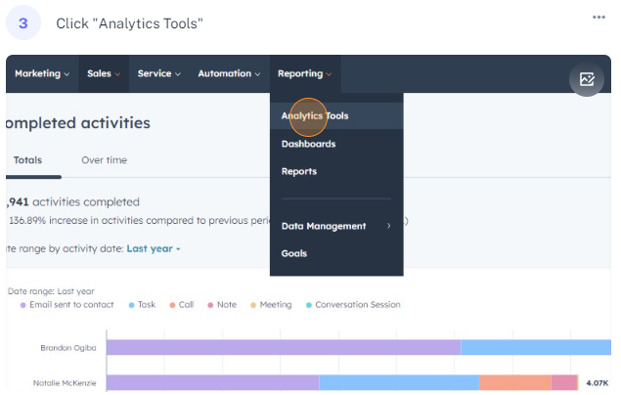
How to Access Sales Analytics and View Completed Activities in HubSpot

Slide 9
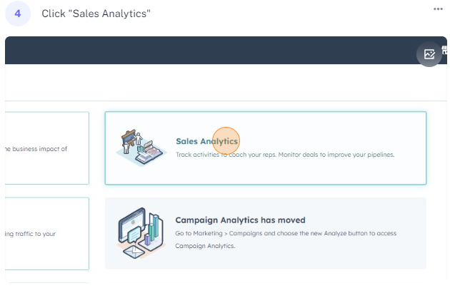
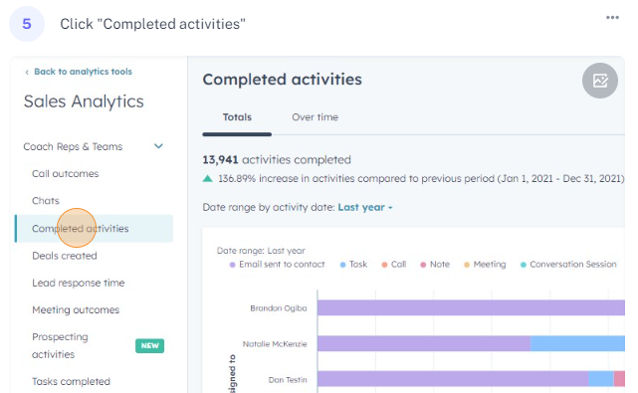
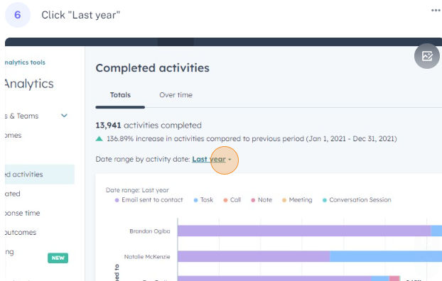
Automate your Reports
If it’s not in Hubspot
It didn’t happen

Slide 10
Putting it together with Metrics
A good baseline for calls should be 60 per day minimum.
100 calls per day is more than doable, top performers will always try to break this number
60-100 calls per day, into target lists with emails and LinkedIn requests, will net you an average of 5 meetings per week with your Ideal Client.

Slide 11
Building out a Process
List Creation
Sequence Creation
Scrubbing Process

Slide 12
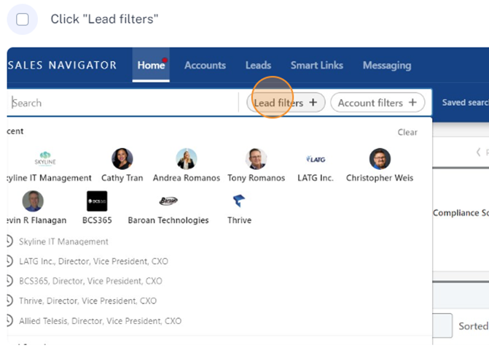
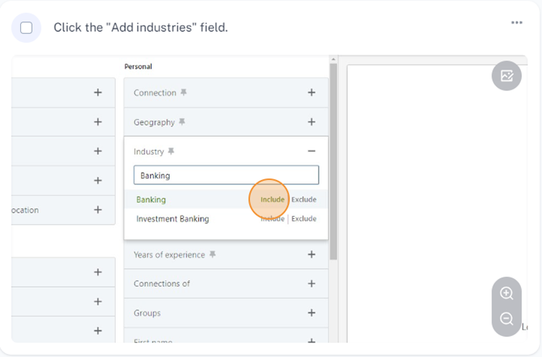
How to Create a Targeted Lead List on LinkedIn
Step 1
Step 2

Slide 13
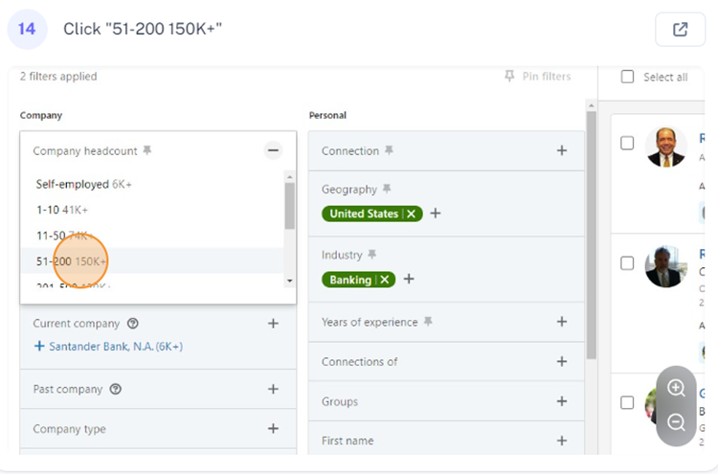
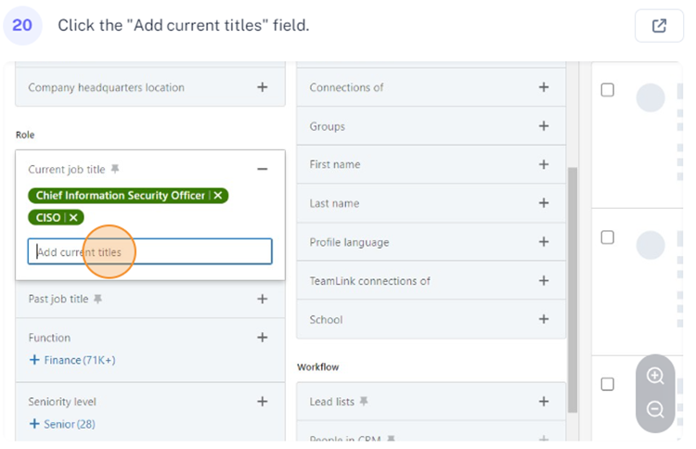
Select Target Company Size and Titles, then Save Search
Step 3
Step 4

Slide 14
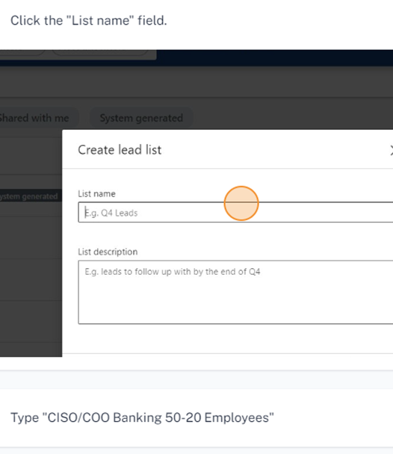
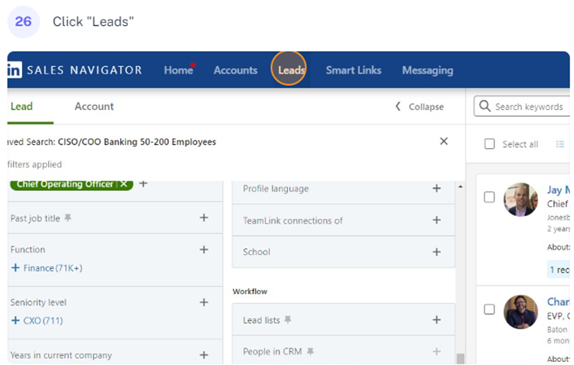
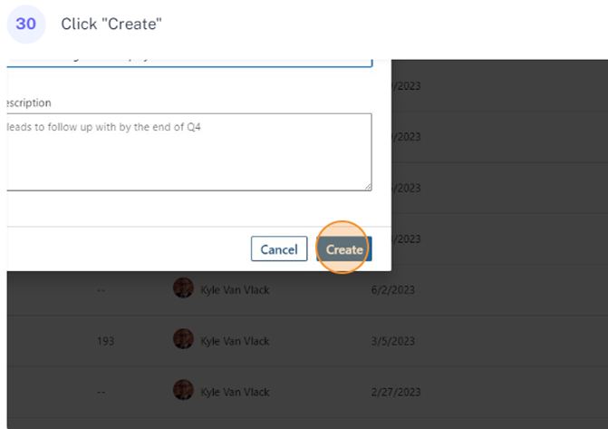
With a targeted saved search you can customize your messaging. Next, create a lead list:
Step 5
Step 6

Slide 15
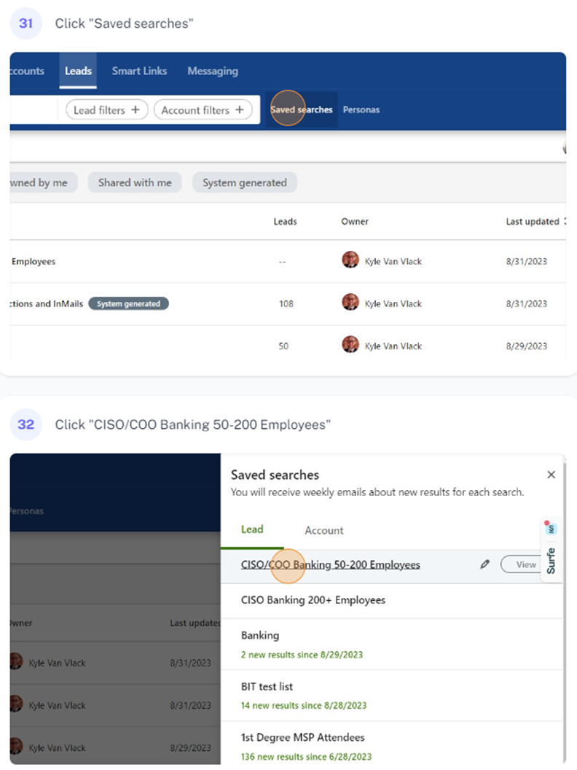
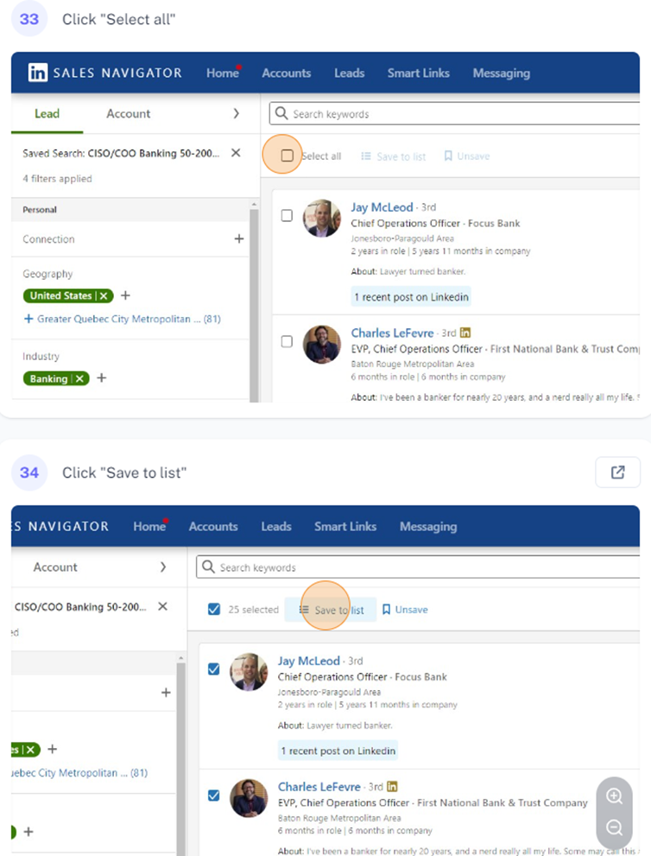
Go back to “Saved Search” and start adding them to your “Lead List.” This will allow more granularity in your initial outreach.
Step 7
Step 8

Slide 16
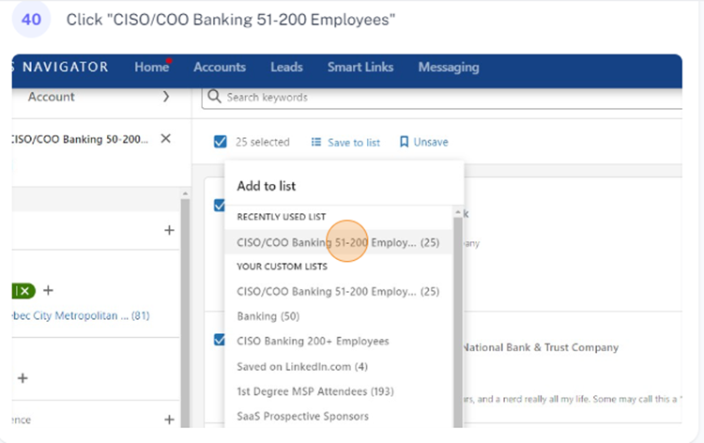
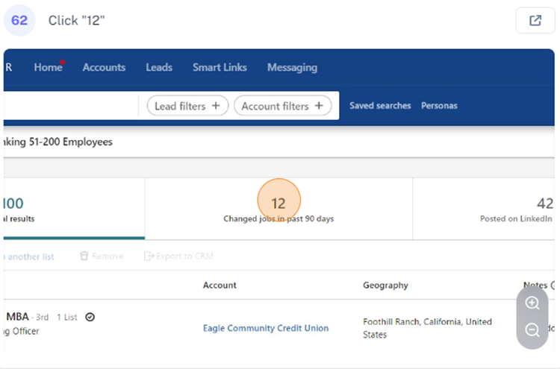
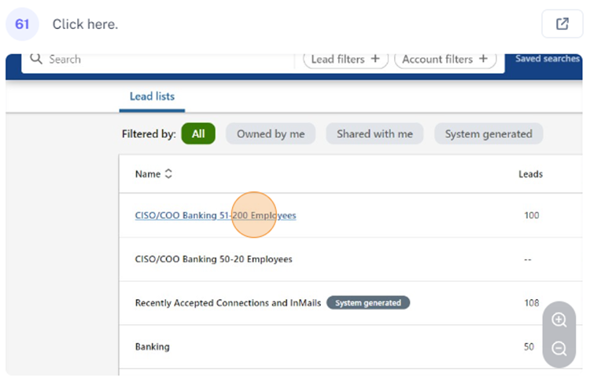
Open the Leads List for focused messaging. For example, it will show job changes in last 90 days, allowing personalized messaging around job change.
Step 9
Step 10

Slide 17
My first message to CISOs in the banking industry at banks with 200-500 employees and less than 1 year in their role would be the following:
You can add a filters to your saved searches, thereby allowing you to make separate lists by industry, tenure and employee count.
Subject Line: Belated Congrats on the New Role!
Hey (First_Name)
I made a list in LinkedIn Sales Navigator, used SalesIntel to clean/enrich that list and verify your email, and sent you this note. The criteria I used were CISOs within the Banking industry at Banks with 200+ employees and less than 1 year in role (according to LinkedIn).
Why? Because we know you have a difficult task ahead of you and believe that we can help.
Insert your value add/CTA here.

Slide 18
This does a few things:
Gets them to open your email, which is over 90% of the battle.
It lets them know you did your research and that you’re honest, establishing trust.

Slide 19
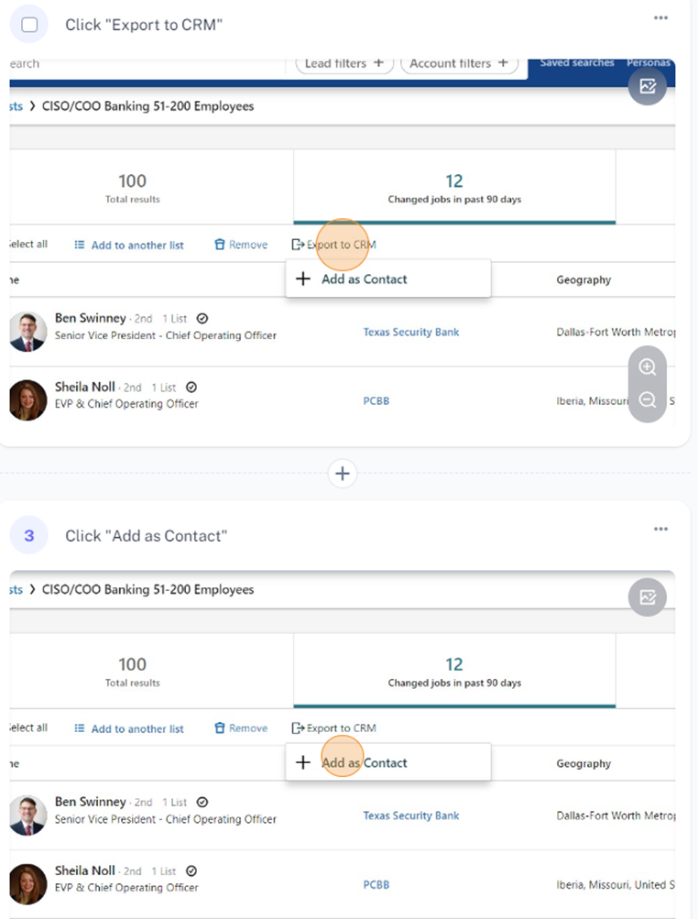
Easily customizable and can be exported directly to your CRM using Sales Navigator Advanced:
Step 11

Slide 20
Sequence Creation
On average, it takes eight cold calls to reach a prospect with a sales cycle of 6 months to one year, or more.
Notes:
A sequence/cadence/workflow with 8 calls and emails over 2 months, then call it quits on those contacts, you have missed a lot of opportunities. The reality is, you will not reach 90% of your prospects (give or take, depending on what you are selling, who you are selling to, etc.).

Slide 21
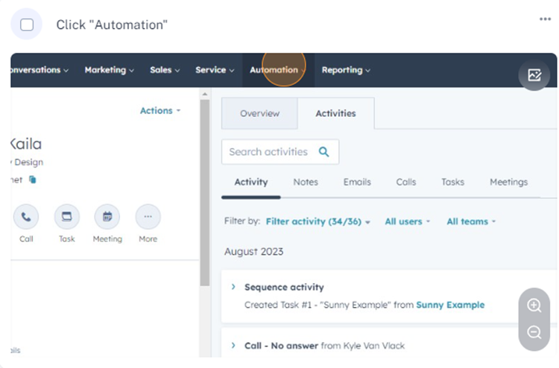
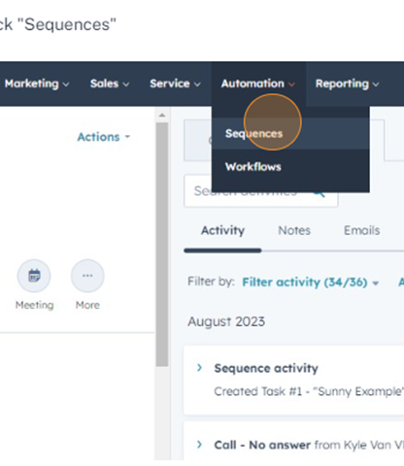
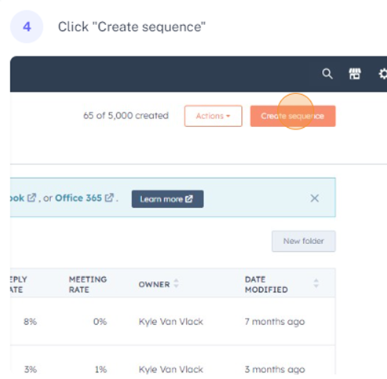
Setting Up a Sequence in HubSpot
Step 1
Step 2
Step 3

Slide 22
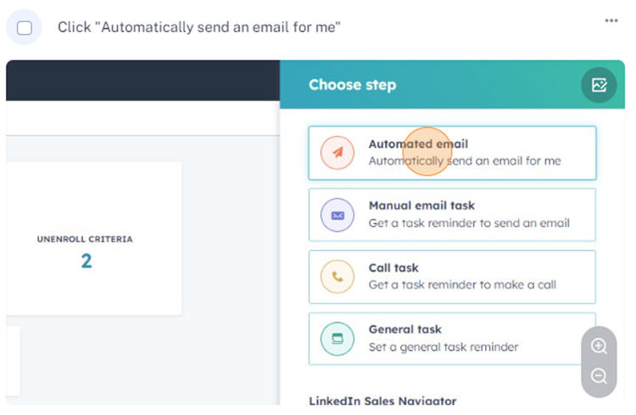
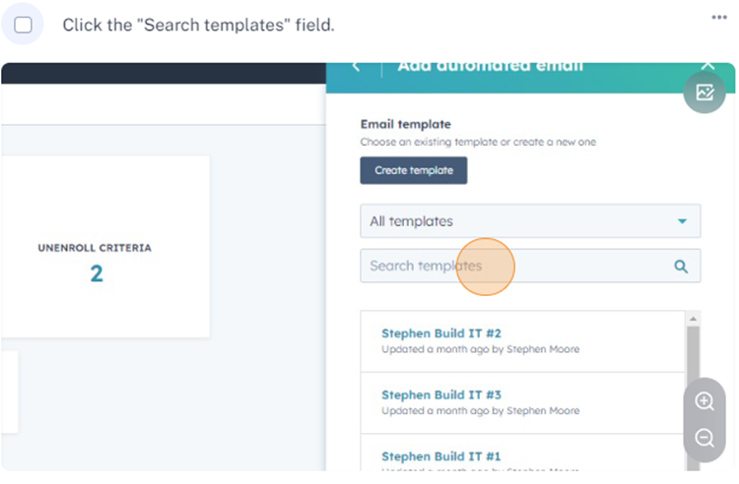
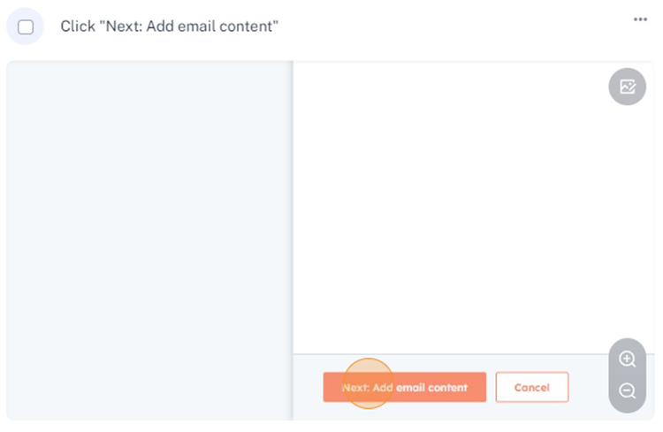
Step 4
Step 5
Step 6

Slide 23
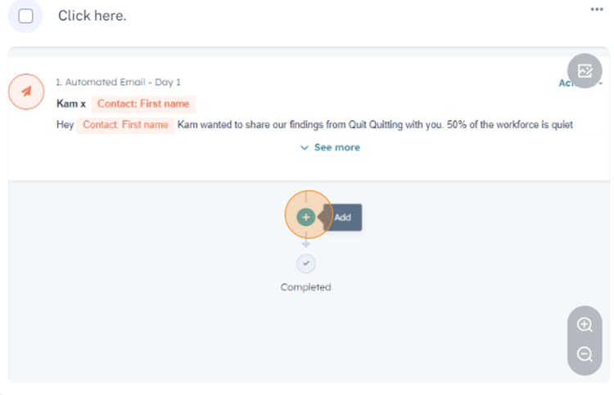
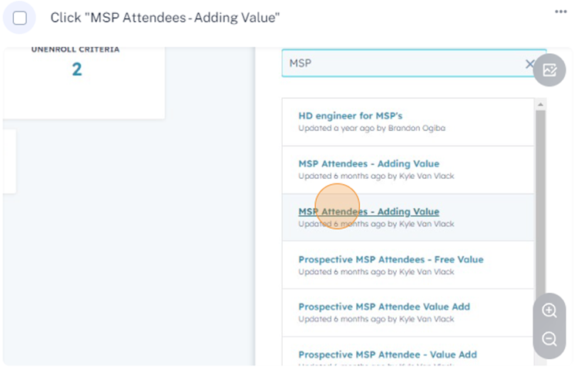
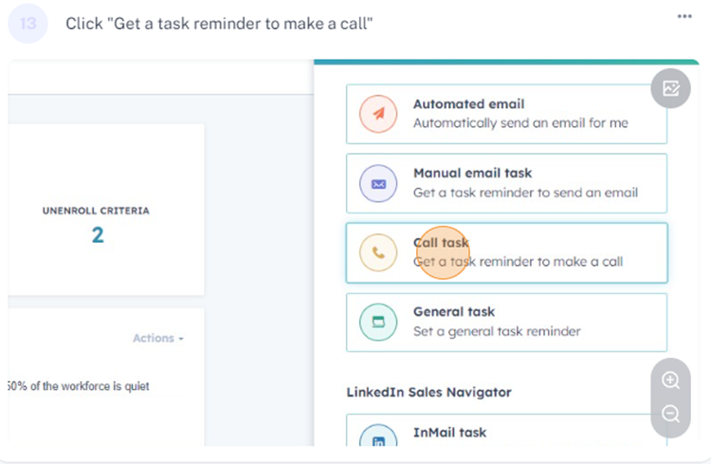
Step 7
Step 8
Step 9
Call sequence: Weekly for 1 month (4 emails and calls)
No response, switch to every other week (alternating call vs. email)
Then Rest: Add to a different sequence or rest for 30 days. Rescrub list or add different contacts from the company. Repeat process.

Slide 24
Scrubbing Process
Your outreach is only as good as the data, so list scrubbing should start, and end, your process.
When running your task for your first call through your CRM, look at the account you’re calling into and add 2 or 3 good contacts from that company to a sequence.

Slide 25
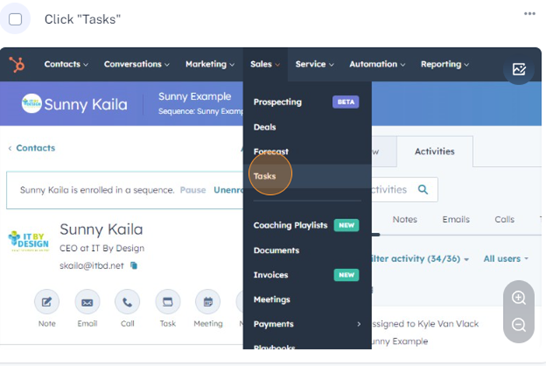
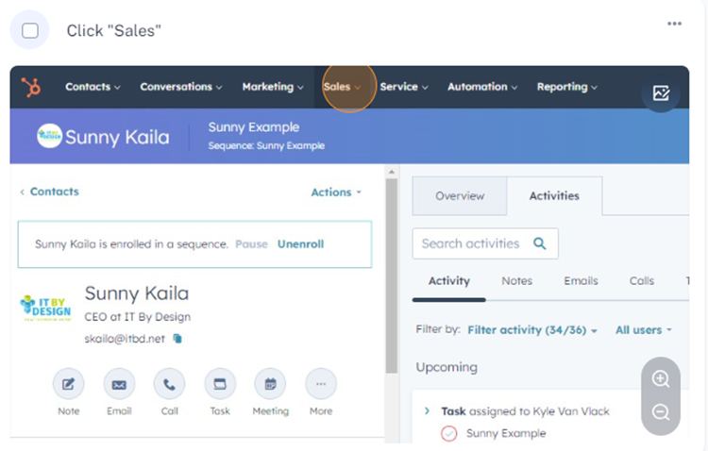
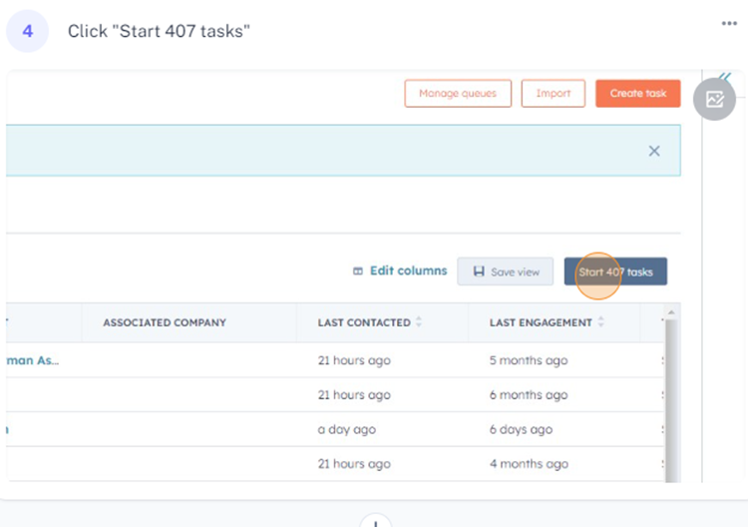
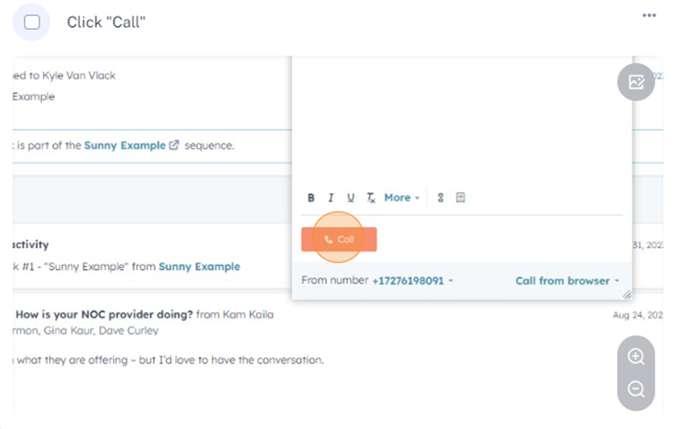
Step 1
Step 2
Step 3
Step 4

Slide 26
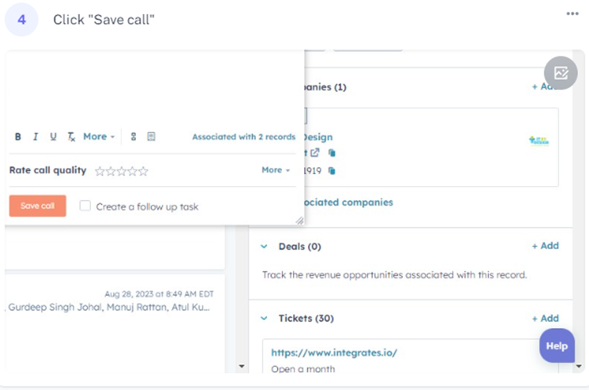
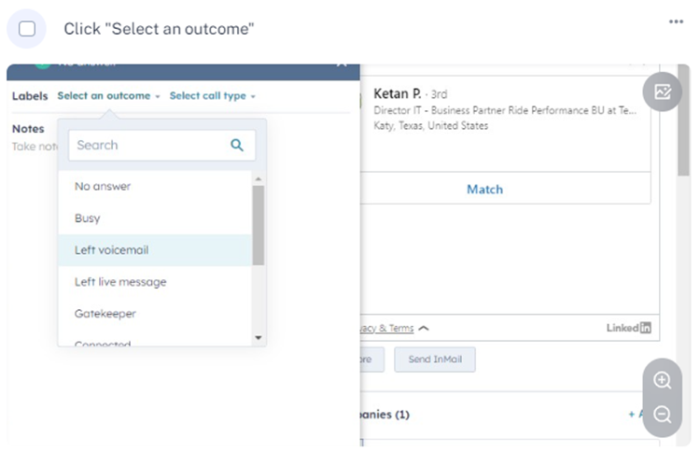
Step 6
Step 5

Slide 27
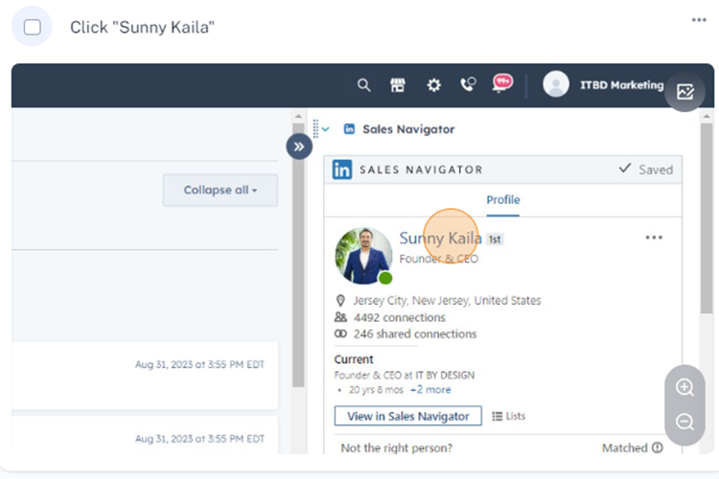
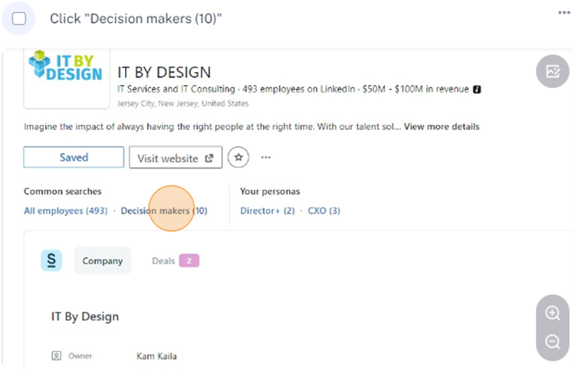
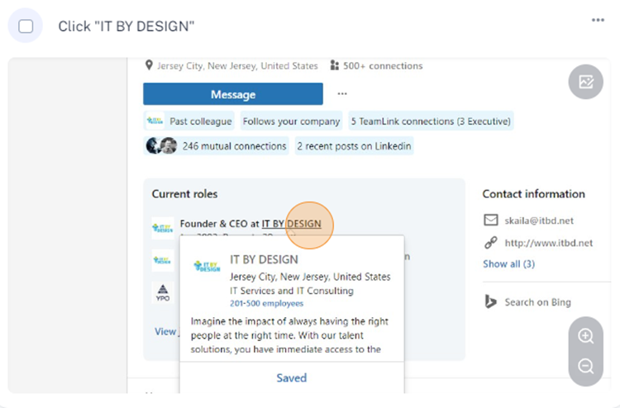
Using LinkedIn Sales Navigator’s integration with HubSpot, you can easily pull up your lead on LinkedIn:

Slide 28
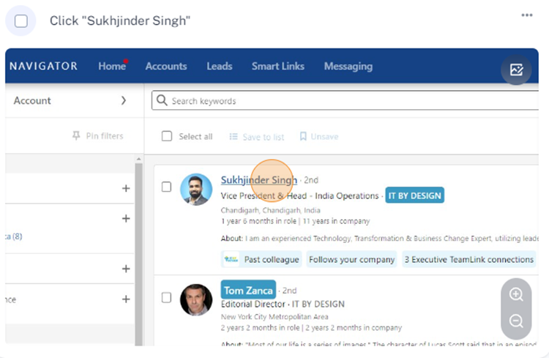
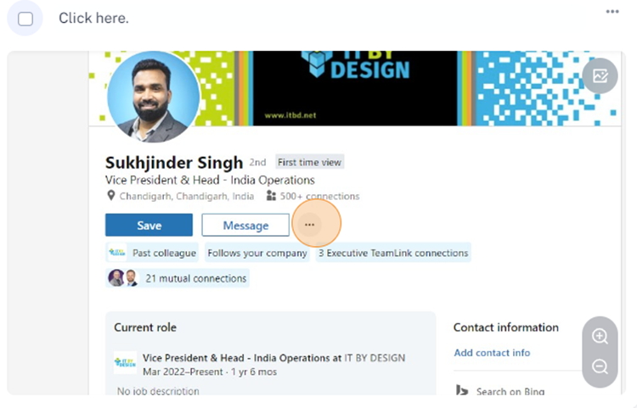
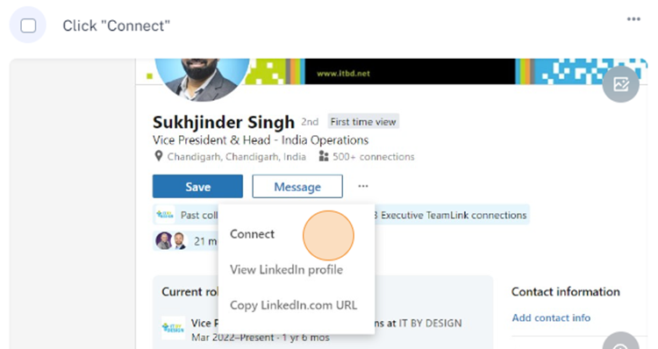

Slide 29
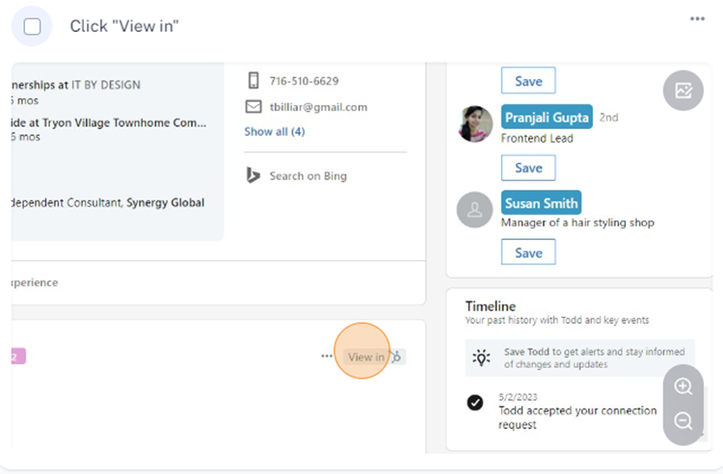
Tip: Using a free tool, like Surfe.com, will allow you to see if a contact is already in your CRM and open the CRM record from LinkedIn. Once you download the Surfe Chrome extension, you will have an icon that says “View In” that will give you the ability to open the contact record in your database.
Tools to Validate

Slide 30
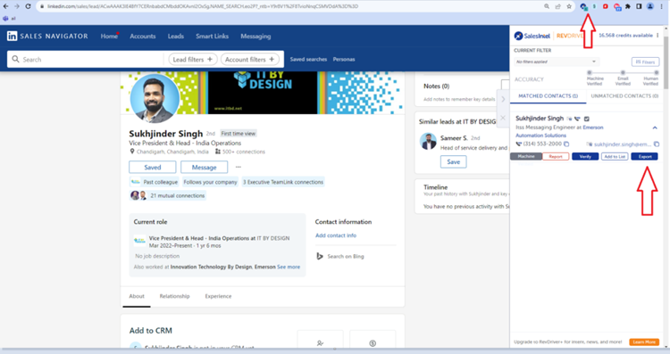
Tools to Validate
Using tools like ZoomInfo, Seamless.ai or SalesIntel Chrome extension over LinkedIn will enable you export your contacts into your CRM while you’re scrubbing the account and pull in the most real-time data possible.

Slide 31
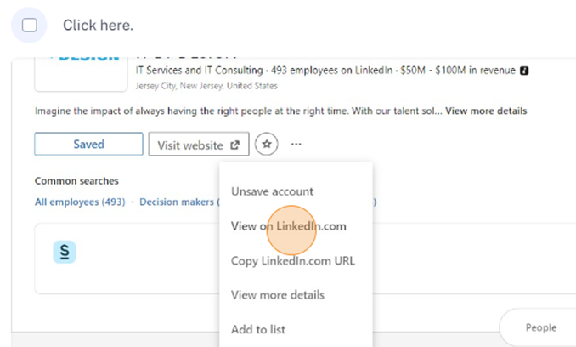
Adding New Contacts
Once you’ve found and imported 2 other good contacts at a company:
call them immediately
leave a voicemail
add to a sequence you’ve prebuilt with an email to go out immediately
Job openings is a great way for an MSP to customize outreach, especially if they’re hiring an Engineer or Helpdesk Tech.
From LinkedIn Navigator, click on the company name, then pull up the company in regular LinkedIn.

Slide 32
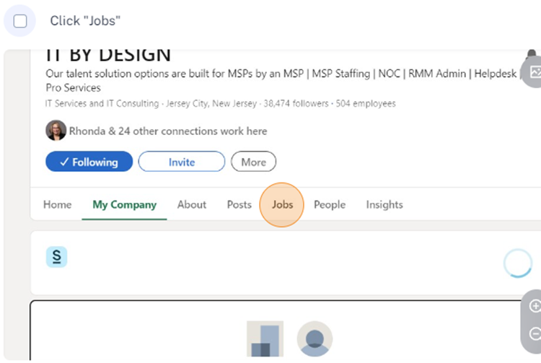
Look for job openings that your company could help fill the gap for, such as Helpdesk Tech.
The first email will have a subject line of the open role, and in the body, you’ll copy and paste a portion of the description or qualifications they’re looking for, tying it back to you and how you can help.
Cc your three contacts you’ve researched at that company on the same thread for this first email.
Not everyone is hiring, so you’ll need to find other ways to customize where possible, but this one is gold!

Slide 33
How to Create and Manage a
LinkedIn Outreach Campaign

Slide 34
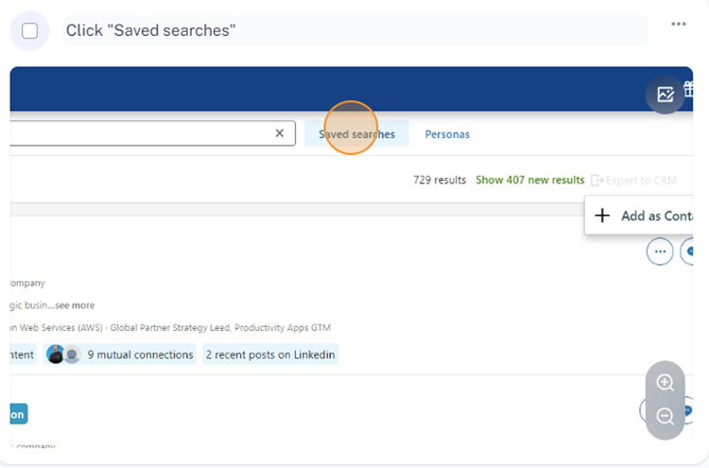

Utilizing a csv file, LinkedIn profile URL or a URL from one of your saved searches on LinkedIn Navigator, you can upload leads to an automated outreach campaign for LinkedIn. You can automate sending out connection requests, liking posts, endorsing skills and sending messages through tools like DuxSoup, Dripify, or Cleverly.
Below how to use your LinkedIn Sales Navigator saved searches URL, to upload leads into Dripify:

Slide 35



From here, you will copy the URL after you select which saved search you want. Next, you’ll go into Dripify to start a campaign, which is where you can then paste the URL.

Slide 36



This is where you will add in the URL from your Saved Search on LinkedIn Sales Navigator:

Slide 37





Build a workflow

Slide 38

From here, you can see all the options available for the next steps of your outreach. You can also export your leads from Dripify into CSV and upload them into a data enrichment tool such as ZoomInfo, SalesIntel, etc.

Slide 39
Let’s Get to Work
Start with 300 leads minimum from any list
upload to a sequence and begin with the 3-pronged approach on the first contact you're calling.
  Phone call with voicemail,
  LinkedIn request
  email.
At 60 dials a day, you can work on that list for a month, calling once per week, leaving a voicemail every other week.
Bring in fresh contacts on the first scrubbing step. Send a connection request and find 2 other good contacts at the company to import to a sequence.
(If they're unqualified, mark it unqualified, remove it from your sequence and move on).

Slide 40
Day 8: Phone call, do not leave a voicemail, send email, view LinkedIn page.​​
Day 15: Phone call, voicemail, send email.​​
Day 24: Phone call, do not leave a voicemail, send email, view LinkedIn page.​​
Day 33: Phone call, voicemail, send email.​​
Day 47: Phone call, voicemail, send email, view LinkedIn page.​​
Day 54: Phone call, do not leave a voicemail, send email, view LinkedIn page.​​

Slide 41
Day 60:
Phone call, voicemail, send email, view LinkedIn page.
Scrub to find better contacts at this point, as it’s been 2 months and they could no longer be there. If the contact is still there, re-enter them into another sequence with a 30-day delay to let them rest.
When a contact reaches the end of a sequence, the last step should be to re-scrub and re-purpose the contact. Maybe they are no longer with the company, you had the wrong number, they never opened your email, etc. Whatever the reason is, you did not get through to them so put them on a renewed sequence after a rest period and try to find several other contacts at the company that fit your desired persona.

Slide 42
Below is a sample voicemail
“Hey {Contact name},
This is {First Name} with IT By Design, we would love to connect with you. Please feel free to call me direct anytime at {Phone _Number}. I will send/I have sent you an email, as well. Again, it’s {First Name} with IT By Design. Thanks {Contact Name}, bye.”

Slide 43



Creating Playbooks

Slide 44


Now that you’ve created your Playbook, you will have easy visibility into this while working your tasks and making calls:

Slide 45

This will pull up the script for you while you're still on the contact record and allow you to log your call from there.

